Slide 1
Predicting phonons and their effects in 2D quantum devices
Laura Rintoul

Slide 2
Overview of presentation
Original project intentions and starting point
Theoretical basis for understanding effects
Open Quantum Systems
Basis for phonon extraction
Development of phonon-electron interaction

Slide 3
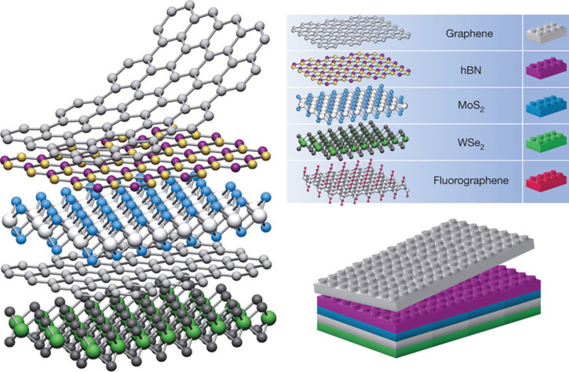
Project background and motivation
2D Quantum Devices are currently of a lot of interest!
Used for many applications: Qbits, single-photon emission
Unique for ability to combine custom built structures
Many of these functions are impacted by phonons
Want to investigate the phonons in them and tie them back in to their function

Slide 4

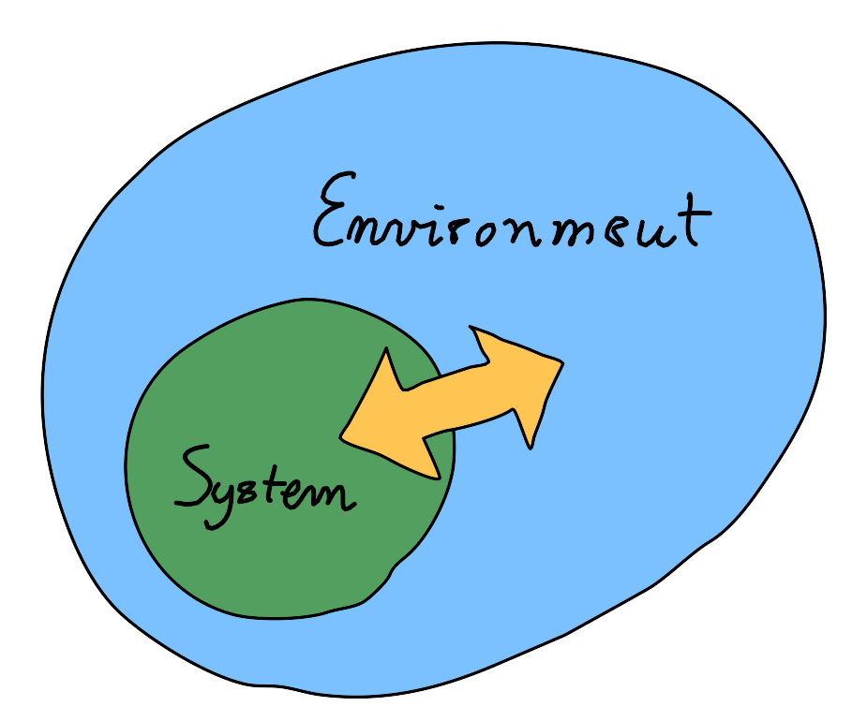
Open Quantum Systems
Method of analysing large systems
Deconstruction of Hamiltonian into system, environment and interaction
System is coupled to some large environment
Allows for following of dynamics of system with a much simpler calculation of environmental effect; reduced density matrix and dimensionality

Slide 5
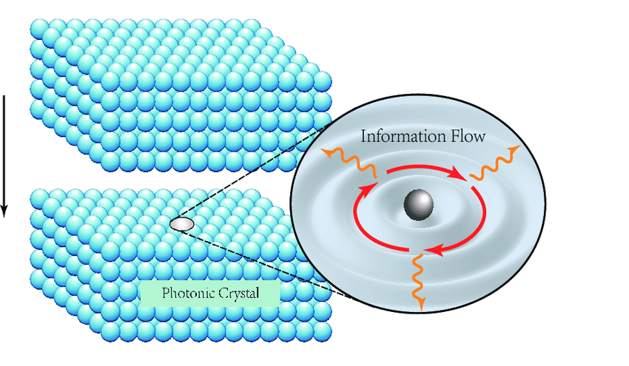



Application to phonons
For e.g. a 2 level system such as a qubit,
Can define environment as a bath of phonons;
OQS treatment results in dynamics being controlled by spectral density

Slide 6
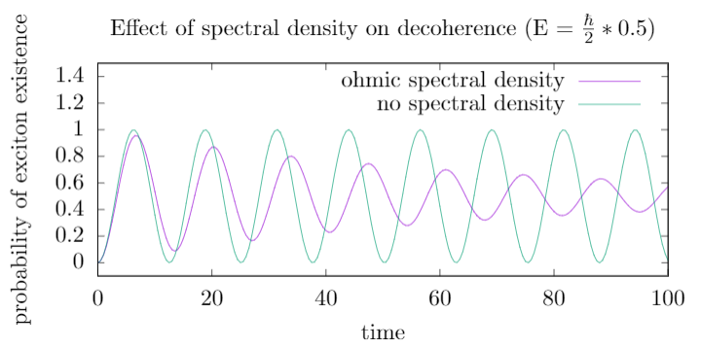


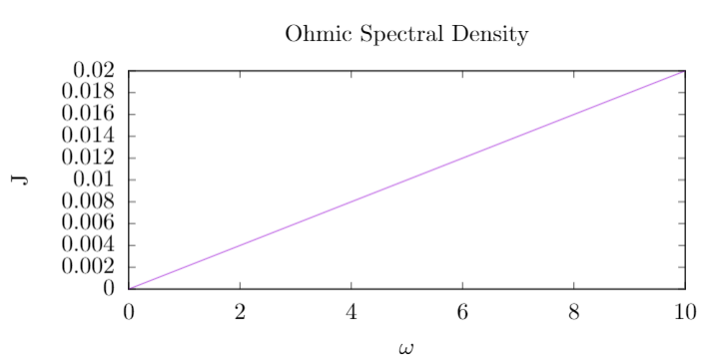
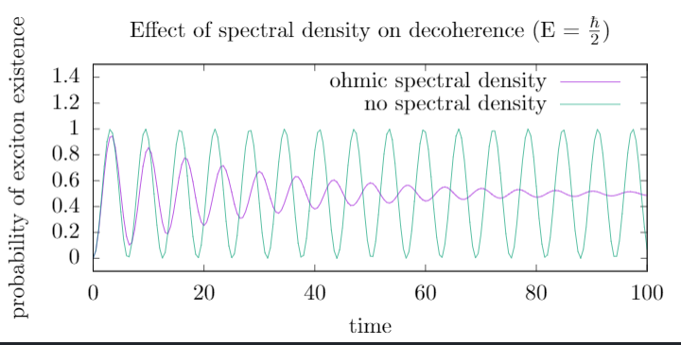
Spectral density effect

Slide 7
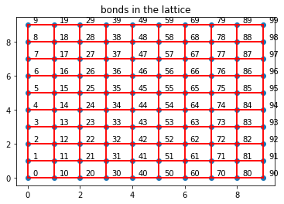
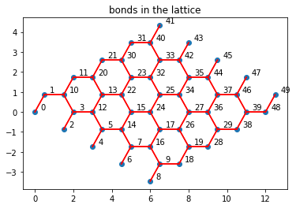
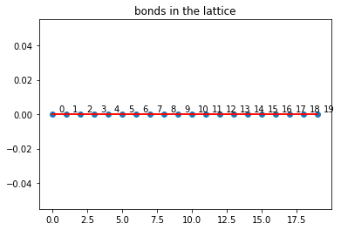
Dynamics Calculation
Simulation of lattice dynamics to calculate phonons; building on honour’s project work to 1D
Programmed lattice phonon calculation for 2D structures

Slide 8
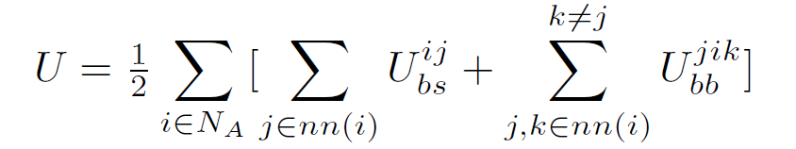
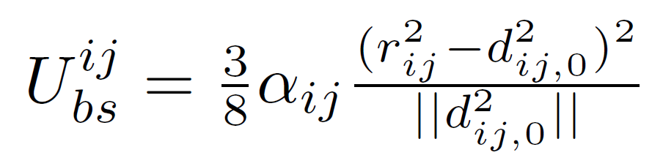
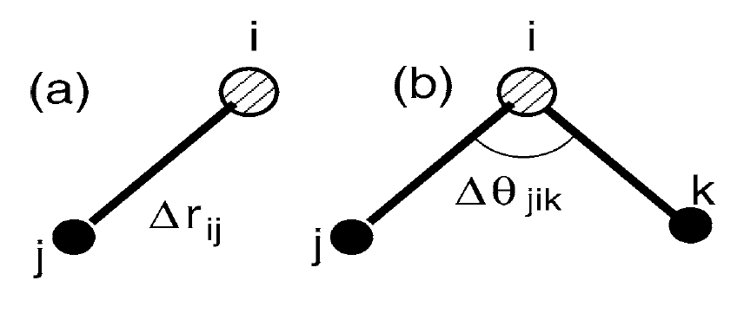
Dynamics Calculation Method
Building on 1D implementation of dynamics calculation from last year

Slide 9
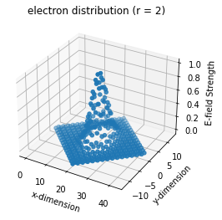
Spectral Density Calculation
Electron is defined as a gaussian over space
g(k) is ultimately deformation of electron ⬄ deformation of lattice
Therefore overlap of change in lattice by phonons with electron density gives g(k)

Slide 10
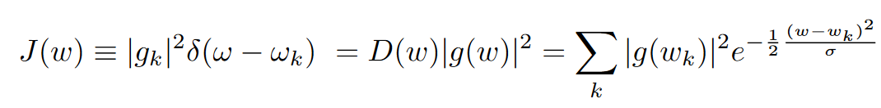
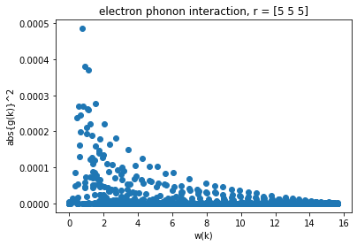
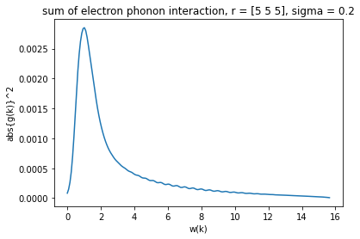
Spectral density calculation
iQUAPI takes continuous Spec. Dens therefore need to use last equation

Slide 11

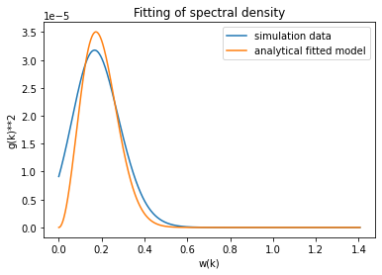
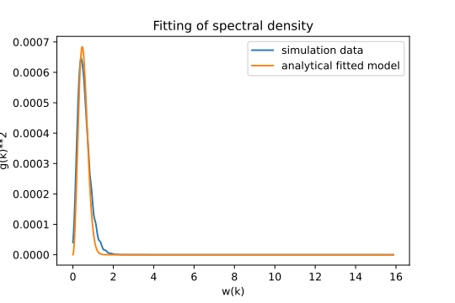
Results: 1D
Analytical derivation carried out gave the following relationship:
r = 5
r = 10

Slide 12
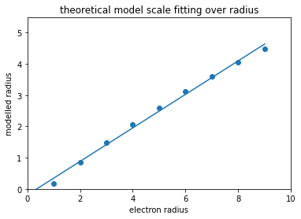

1D analysis
Analytical derivation carried out gave the following relationship:

Slide 13
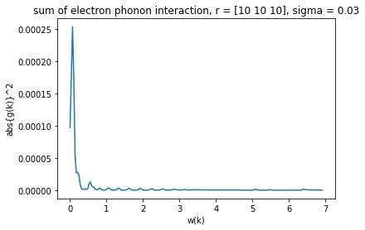
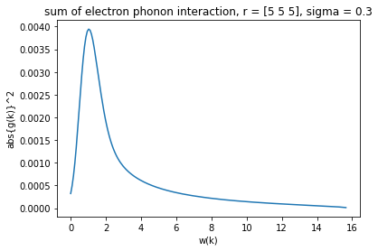
2D Phonon spectral densities
50 by 50 unit cells honeycomb lattice
50 by 50 unit cells grid lattice

Slide 14
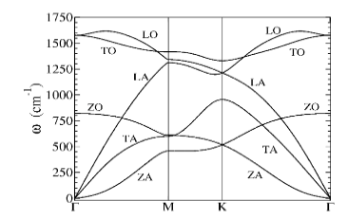
Honeycomb analysis

Slide 15
1D vs 2D comparison

Slide 16
Further work
Analysis of other lattice structures
Modelling of 2D phonons for plotting to verify analytical accuracy
Larger computations to rule out finite size effects
Analysis of direct effects of calculated phonon spectral densities

Slide 17
Thank you!
Questions

